Slide 1
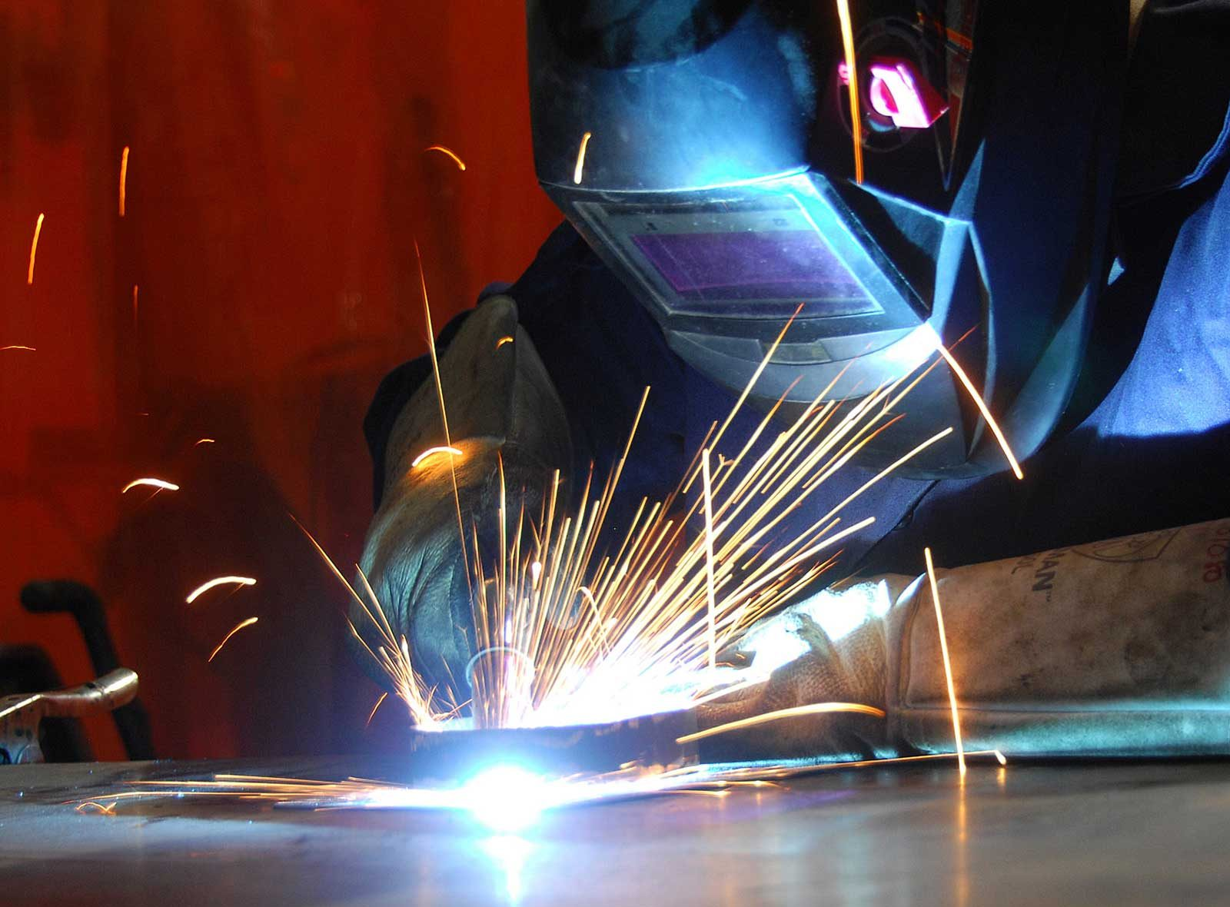
nat5 Design & Manufacture
Metal Manufacturing

Slide 2


Learning intentions & success criteria
Learning Intentions
Develop an understanding of metal manufacturing processes.
Investigate existing metal products to determine the process used to make them.
Success Criteria
I can analyse a product and identify the manufacturing processes used to make it.
I can name the steps for each manufacturing process.

Slide 3
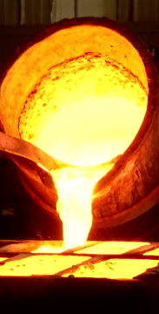
Joining metals
This topic will cover:
    1. Ways of joining metal together.
    2. Metal Processes
        Turning Metal (lathe)
        Sandcasting
        Die Casting
    3. Finishing Metals

Slide 4
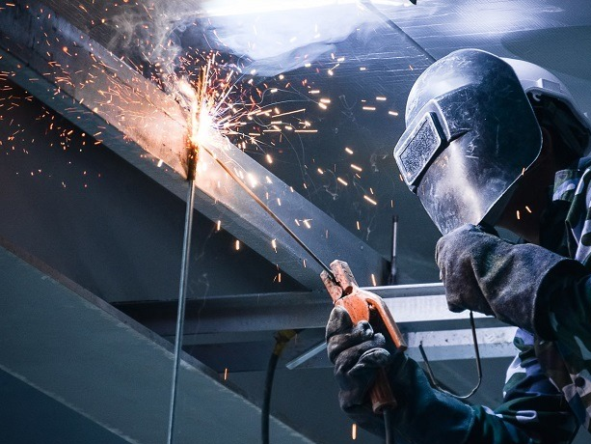
Joining metals
There are two main ways to join metal:
TEMPORARY
Using screws, nuts and bolts.
PERMANENT
Using rivets, welding, soldering, brazing.

Slide 5
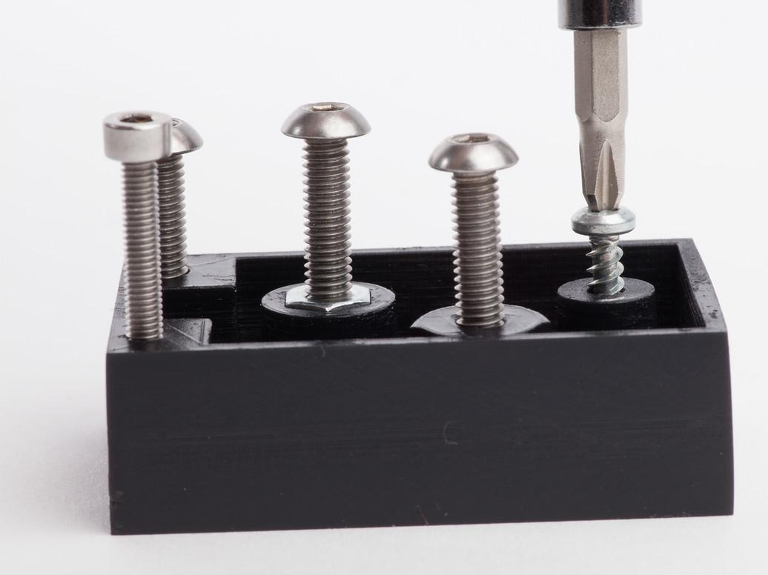
Joining metals temporary
Screw threads are very important in engineering.
It is used to hold parts together (nut and bolt).
In the metal workshop, we use a TAP and DIE to create the screw thread.

Slide 6
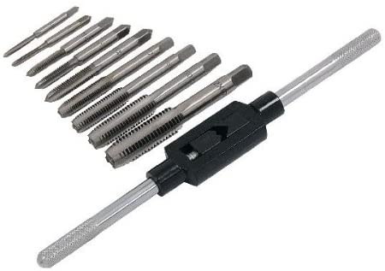
Internal screw cutting
To create an INTERNAL screw thread, we first must drill a hole.
Next, we use TAPS, made from High Speed Steel.
A TAP WRENCH secures the tap:

Slide 7
Internal screw cutting
1
2
3
Taps are generally available in sets of THREE, used in the following order:
  TAPER TAP
  SECOND TAP
  PLUG TAP

Slide 8
Internal screw cutting
A BLIND HOLE is a hole which has a bottom to it e.g. on the handle of the toffee hammer.
You must indicate the depth on the TAP before threading the hole, to avoid damage to the TAP.
You could do this using masking tape.
X
X

Slide 9
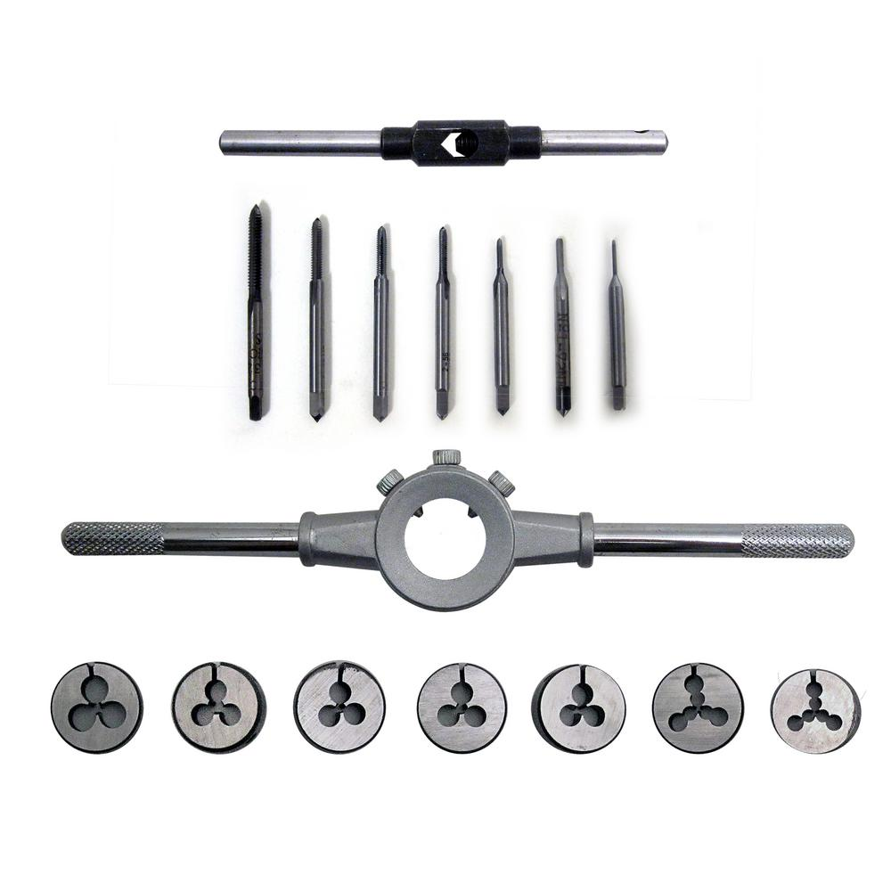
external screw cutting
To create an EXTERNAL screw thread, we use a DIE.
A circular split die is the most common type.
The split die is held in a DIE HOLDER or STOCK

Slide 10
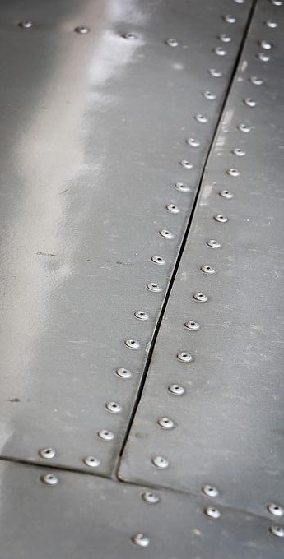
Joining metal
Permanent
RIVETS are used to join plates together, and have been used for hundreds of years e.g. ship building, bridge building.
COLD RIVETS are used in school, although the modern POP-RIVETING technique is more popular.

Slide 11
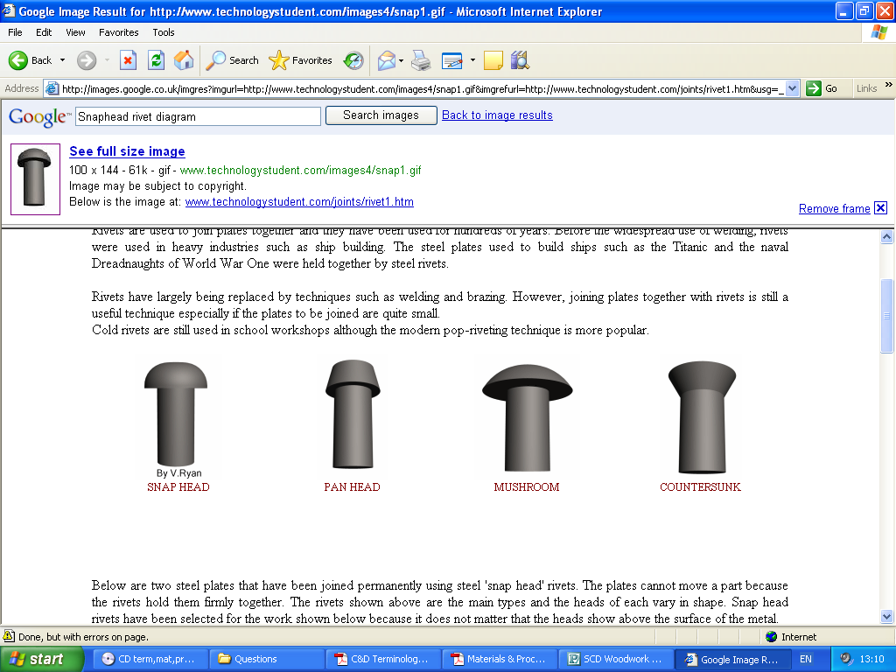
Types of rivet
SNAPHEAD
PANHEAD
MUSHROOM
COUNTERSUNK

Slide 12
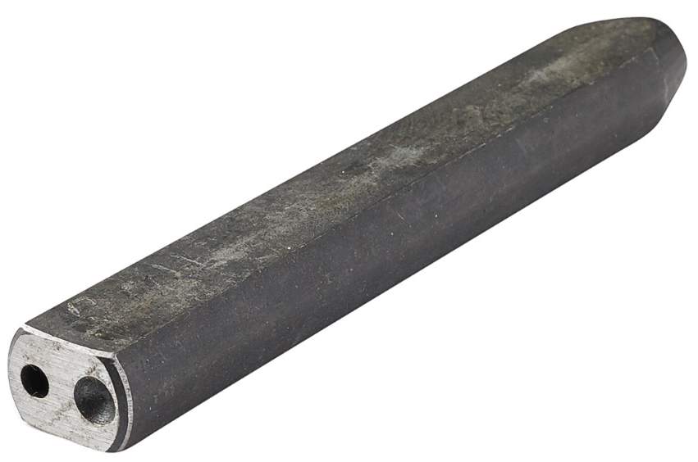
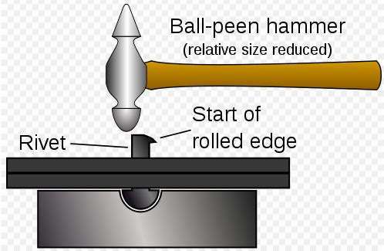
Rivet set and snap
This tool allows us to ensure that the metal being joined and the RIVET are held together firmly.
A ball pein hammer is used to flatten the rivet.
Ball Pein Hammer
Rivet
Start of rolled edge

Slide 13
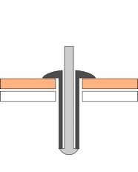
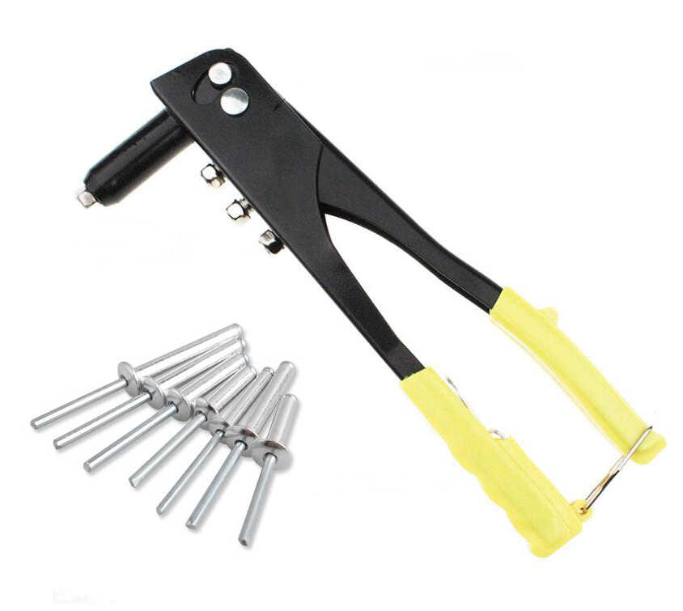

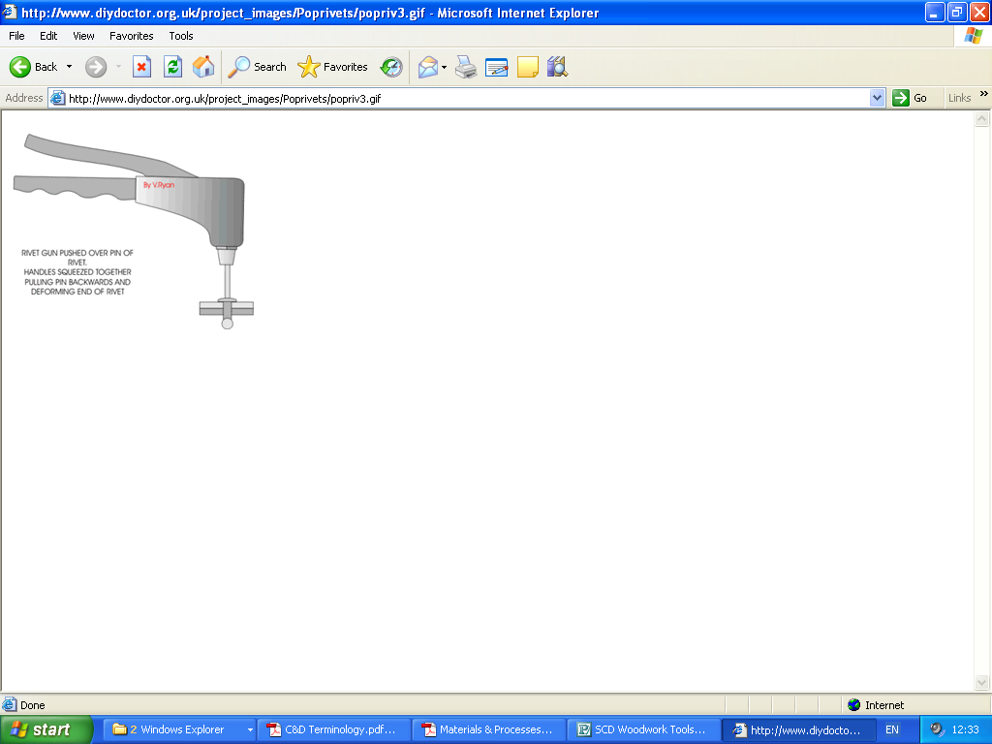
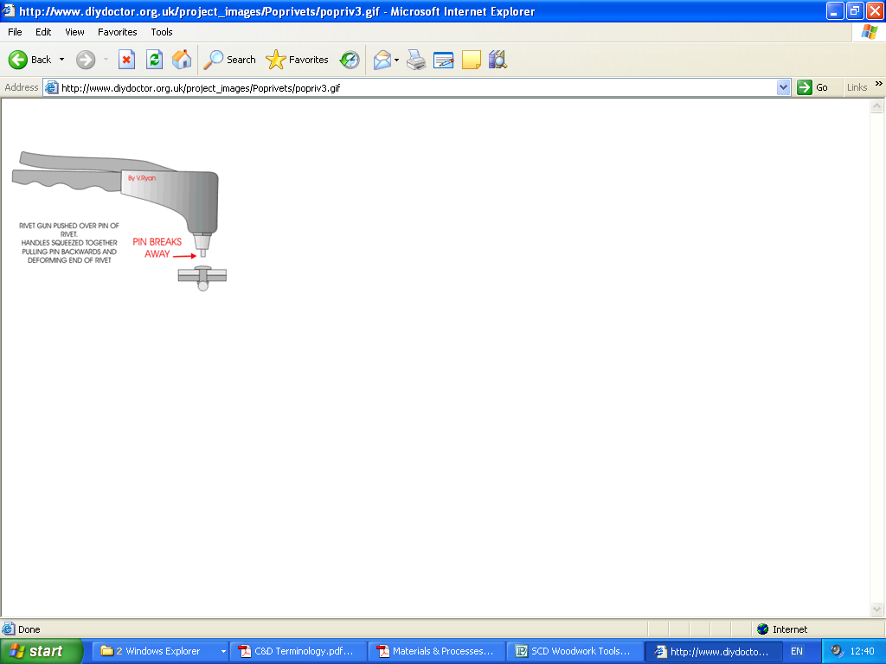
Pop rivets
POP RIVETING is when the rivet is placed in the hole of the metal being joined.
A RIVET GUN is then placed over the rivet and the handles are squeezed together.
The rivet will expand until the pin breaks away.
Pin Breaks
away

Slide 14
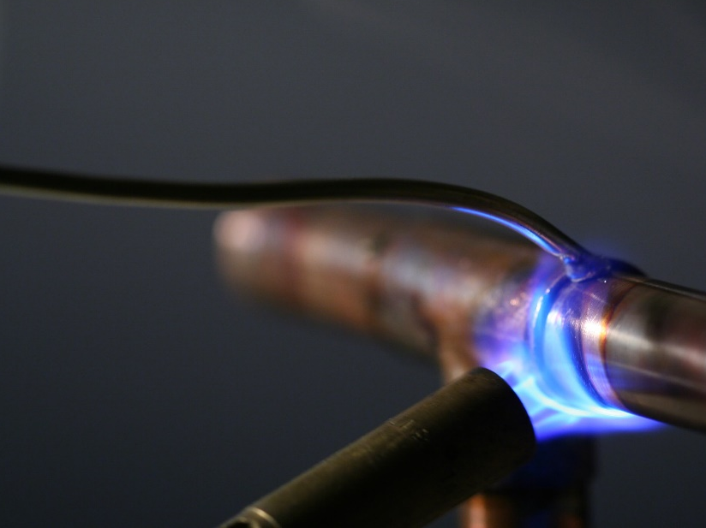
Thermal joining
SOLDERING and BRAZING are joining processes where materials are bonded together using
    HEAT
    A FILLER metal
This is done WITHOUT melting the base metal.

Slide 15
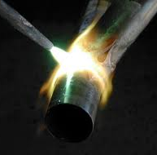
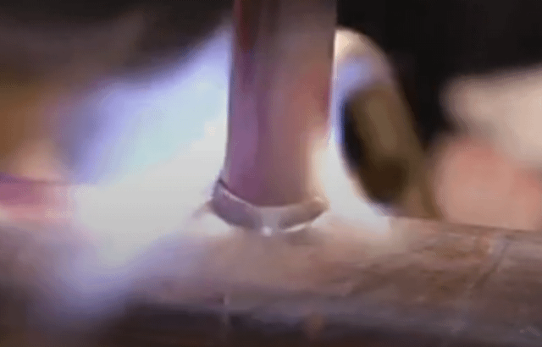
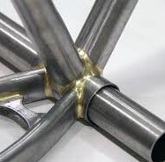
brazing
Brazing temperature is MORE than 450°C
Brazing is used for:
  Joining sheet metal
  Joining thin metal bars/rods
  Joining copper and copper alloy pipes
PROCESS:
  A gas air torch such as those in a forge is used to heat the filler metal
  This is then melted along joints and left to cool and solidify

Slide 16
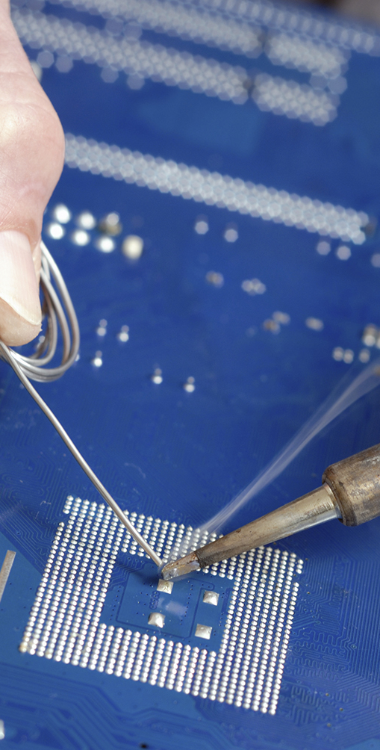
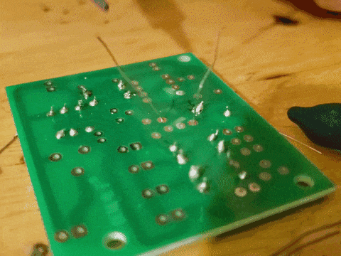
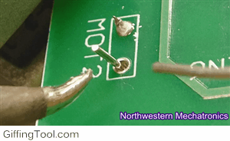
soldering
Soldering temperature is LESS than 450°C
Soldering is used for:
  Thin sheet metal
  Thin bar
  Circuit boards in computers
PROCESS:
  The soldering iron is heated (electrically or in a forge)
  Once hot enough it is used to melt a filler metal along the joint of the metals being put together.

Slide 17
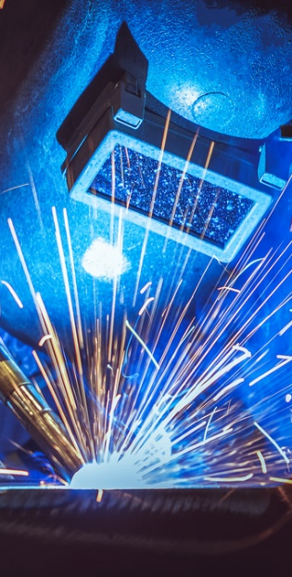
welding
WELDING is the process of joining two metals by melting the base metal and using a filler material to form a joint.
There are two types you need to know:
  Spot/Resistance Welding
  Arc Welding

Slide 18
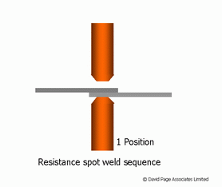
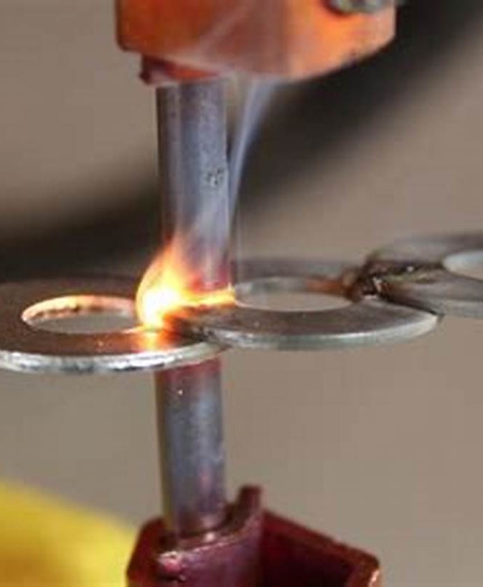
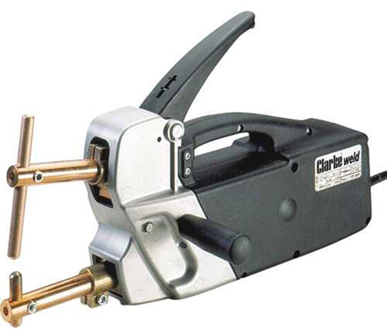
Spot welding
SPOT WELDING is used for:
  Joining thin sheet metal
Process:
  An electric current is passed through copper rods and the metal being joined
  This causes heat to build up and melt the metal together
Example, used for:
  Car production: welding panels together

Slide 19
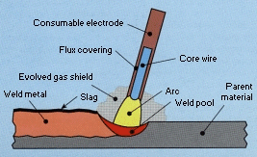
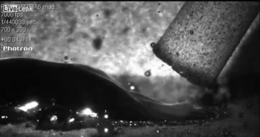
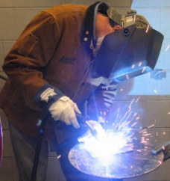
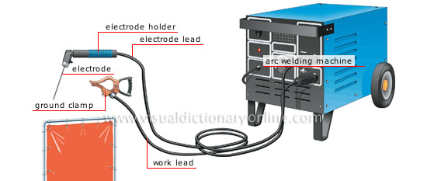
arc welding
ARC WELDING is used to join thick metals including bar form and round form.
Process:
  A metal rod is held in an electrode holder
  The electricity produces heat
  This melts the metal being joined
  The metal rod acts as filler material and fills the gap to create a solid weld
Electrode Holder
Metal Rod
Ground Clamp
Safety:
Ensure that you always wear a welding mask as your eyes can be damaged and ensure that you are working in an area away from others.
1
2
3

Slide 20
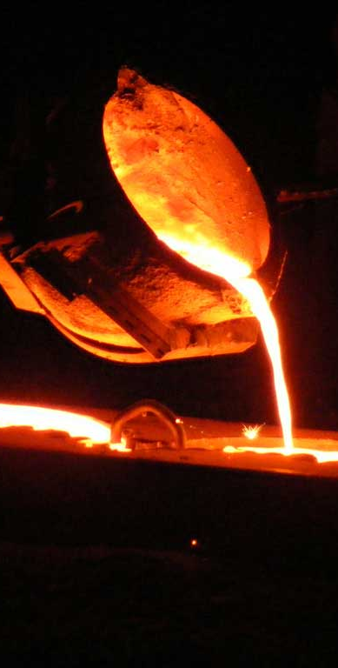
Manufacturing processes
You need to understand and explain the following three processes:
  Metal Turning
  Sand Casting
  Die Casting
  Finishing Metals

Slide 21
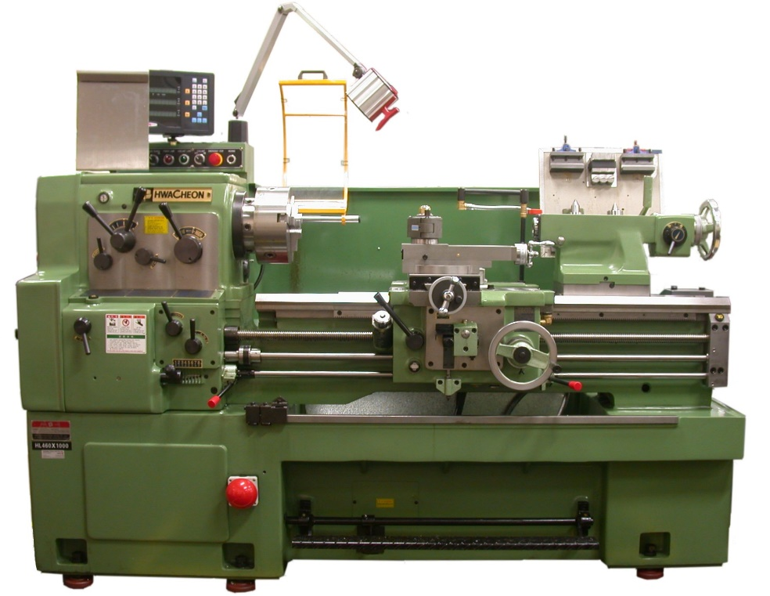
Metal turning
TURNING is the process of removal of metal from the outer diameter of a rotating cylindrical work piece on a lathe.
There are various processes we use in the workshop which you need to know:

Slide 22
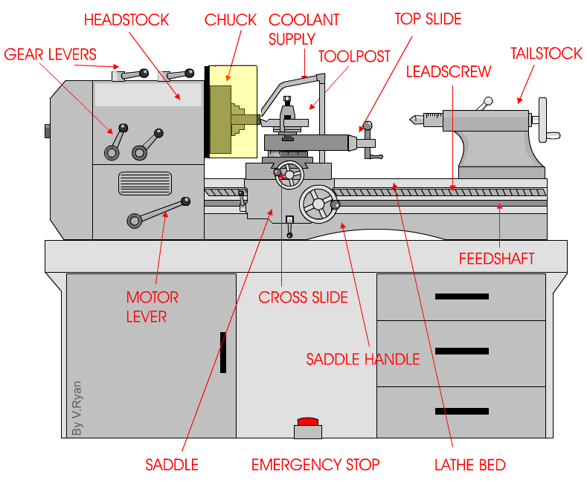
Metal lathe

Slide 23
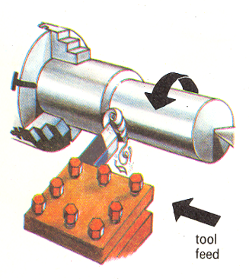
Turning processes
FACING OFF
  Cutting across the end of a work piece
  Done at the start of a new job
PARALLEL TURNING
  Cutting parallel to a job
  This allows you to reduce the diameter
tool feed
tool feed

Slide 24
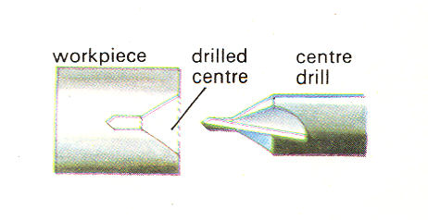
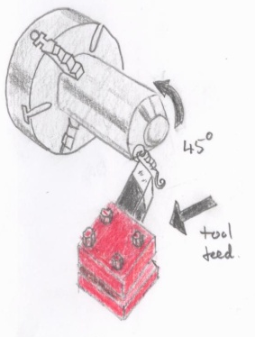
Turning processes
CENTRE DRILL
  Used to drill a centre hole before you drill the main hole.
CHAMFERING
  Creating a slope on the edge of a piece of metal
  Usually (but not always) at an angle of 45°
45°
tool feed

Slide 25
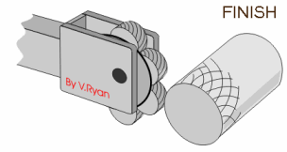
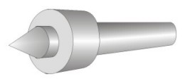
Turning processes
Finish
KNURLING
  Process of engraving a diamond-shaped pattern onto the metal
  Improves grip of handles etc.
REVOLVING CENTRE
  This is secured in the tailstock
  Allows the bar to revolve freely and secures it in place etc.

Slide 26
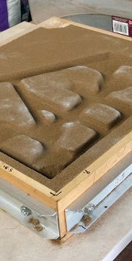
Sand casting
SAND CASTING is the process of making shapes or components using:
  Pre-shaped objects
  Sand.
Example:
  Engineer’s vice on the workbench
The vice will have been cast in two separate castings
The bottom part is called the DRAG
The top part is called the COPE
This process is suitable for Low-volume numbers (time consuming and mould has to be made each time)

Slide 27
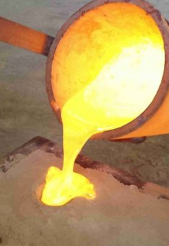
Sand casting
Identifying Features:​
Rough surface texture​
One-piece construction​
Tapered sides​
Split lines where the two halves have joined together​
Fillets and rounded corners​
Fettle marks due to removal of runners, risers or split lines.​

Slide 28
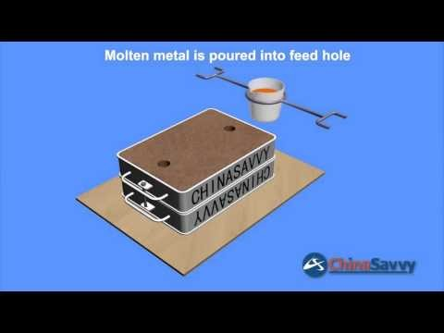
https://www.youtube.com/watch?v=EIBDp6U8bHo

Slide 29
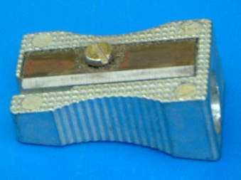
die casting
The DIE CASTING process is the metal equivalent of “injection moulding” used for plastic.
Process:
  Molten metal is forced into a mould (a die)
  The dies are made from a special steel alloy which is very expensive to make
  Suitable for high volume production
  Can produce highly complex shapes
Identified from ejector pin marks on the metal.
Benefits to the manufacturer:​
Can achieve intricate detail​
Suitable for mass production​
Speed of production​
Inexpensive process​
Good surface finish/looks good​
Components are all identical​

Slide 30
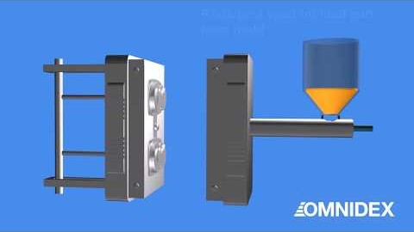

Slide 31
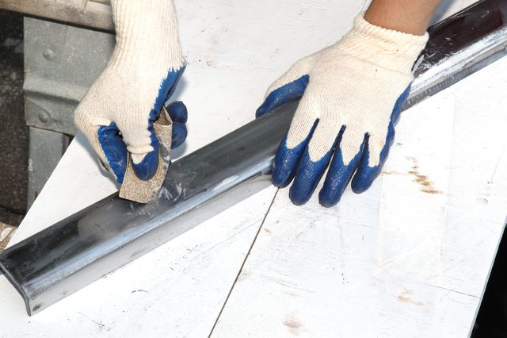
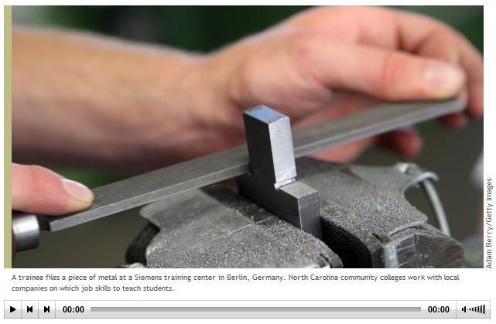
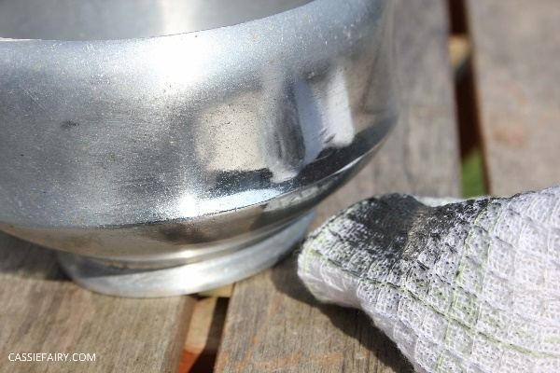
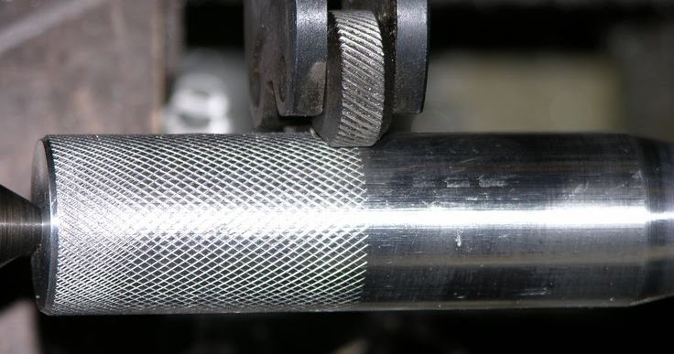
Finishing metals
There are a number of different techniques to finish metal:
  Emery paper (Abrasive paper- similar to sanding wood)
  Filing (cross filing to shape and draw filing to smooth)
  Polishing
  Knurling (diamond pattern)
Emery Paper
Filing
Polishing
Knurling

Slide 32

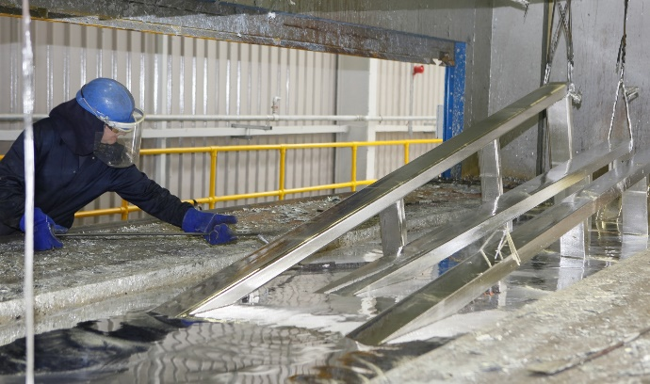
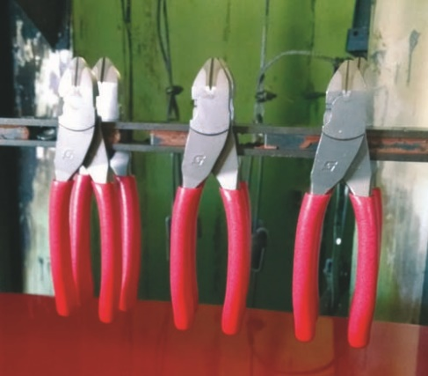
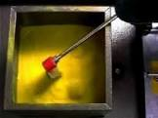
Finishing metals 2
  Painting (Paint brush, spray paint etc.)
  Galvanising (adding a protective coating of ZINC to a metal)
  Plastic dip-coating (a process to coat metal in a protective layer of plastic)
    The metal is heated in an oven or forge, then placed in a fluidiser where the plastic powder bonds to the metal.
    https://www.youtube.com/watch?v=a2BWZFyGhb0
Painting
Galvanising
Dip coating- Example
Dip coating- Fluidiser

Slide 33
Mass production
  Benefits of

Slide 34
task
You will be given the number of one of the following metal processes to research:
  Die casting
  Sand casting
  Metal turning
Task:
  Create a PowerPoint Presentation (3 slides minimum).
  Include the following information:
    Overview of the process
    Stages in the process
    Example products
    Benefits of this process
You may be selected to present to the class.

Slide 35
METALWORK hand and machine tools
Outside Callipers
Odd-leg Callipers
Steel Rule
Spring Dividers
Centre Punch
Scriber
Engineer’s Square
Hacksaw
Jr Hacksaw
Ball-pein hammer
Hide Mallet
File
Tin Snips
Bending Bars
Pillar Drill
Centre Lathe
You should learn the following tools, their purpose and how to describe using them. There will inevitably be a question based on metal manufacture in the exam, so ensure you remember them!

Slide 36
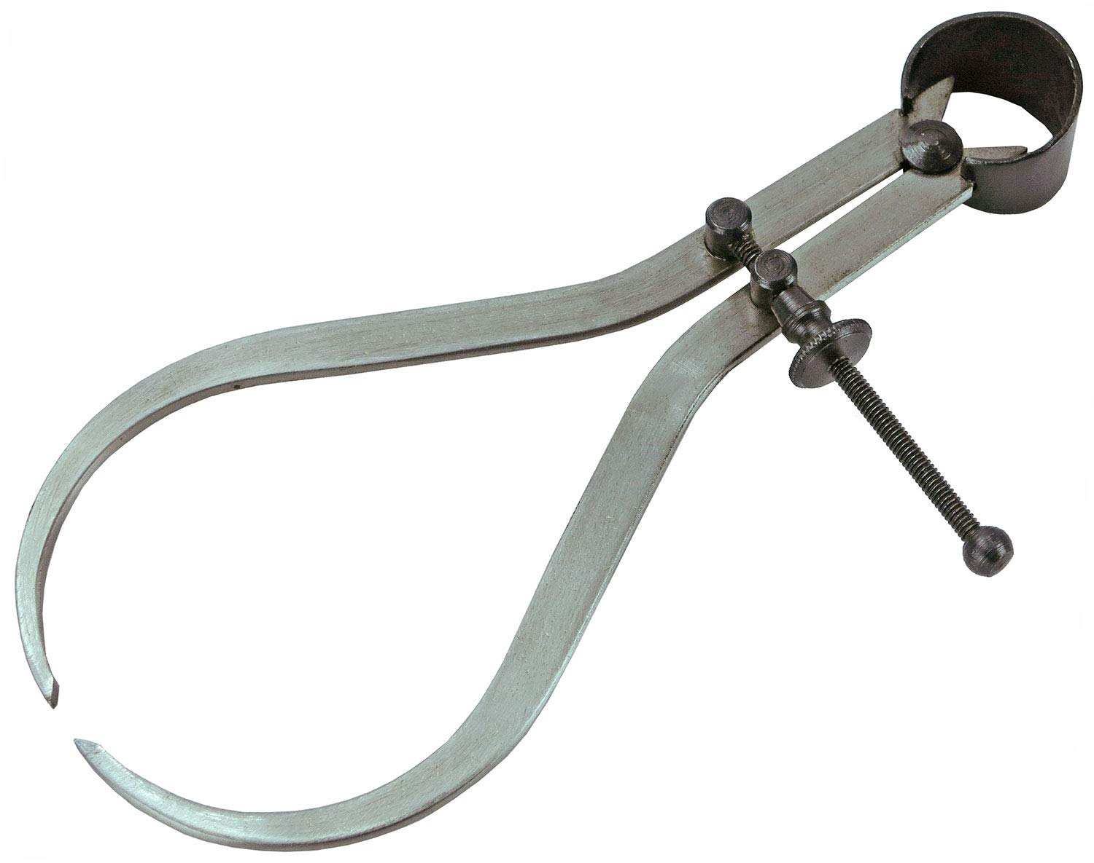
Outside callipers
Outside callipers measure thicknesses and outside diameters of objects; inside callipers measure hole diameters and distances between surfaces. To check the dimensions of a machined part, the callipers are first adjusted to the required dimension on a ruler

Slide 37


Odd-leg callipers
Oddleg calipers (aka Hermaphrodite Calipers) are used mainly to scribe lines parallel to the edge of metal (or plastics).
They are used for much the same reason that a woodworker might use a Marking Gauge.

Slide 38

Steel rule
For measuring sizes on wood, metal and plastic.
The “0” of the steel rule starts right at the edge.
Sizes are in mm.

Slide 39

Spring dividers
Spring dividers are used for marking out work. Sharp points can be used to scribe the work piece, creating arcs and circles.
They can also be used to measure the distance between two points. They provide a high degree of accuracy and repeatability.

Slide 40

Centre punch
A centre punch is used to mark the centre of a point. It is usually used to mark the centre of a hole when drilling holes.
A drill has the tendency to "wander" if it does not start in a recess. A centre punch forms a large enough dimple to "guide" the tip of the drill.

Slide 41

scriber
A scriber or engineers scribe tool is a type of hand tool used to mark or scriber various materials such as wood, steel, metal and plastic prior to being machined.

Slide 42

Engineer’s square
An engineers square, also known as a Machinist square, is a handheld marking and checking tool used to assess angles and mark straight lines.
Made up of two straight pieces (stock & blade) which work together to create a right angle at exactly 90°.

Slide 43

hacksaw
A hacksaw is a hand-powered, small-toothed saw used for cutting metal pipes, rods, brackets, etc. Hacksaws can also cut through plastic.
The hacksaw has a U-shaped frame and a handle at one end. Hacksaws have small pins at each end of the frame that receive a blade.

Slide 44

Jr hacksaw
Junior hacksaws are a smaller variant used when space is limited, or more precise cutting is required.
They feature softer, half-sized blades and so are not suitable for cutting harder substances.

Slide 45

Ball-pein hammer
The ball-peen hammer is useful for many tasks, such as striking punches and chisels (usually performed with the flat face of the hammer).
The peening face is useful for rounding off edges of metal pins and fasteners, such as rivets.

Slide 46

Hide mallet
Rawhide mallets, which may employ rawhide covering a steel head, or simply consist of rolled-up rawhide, are used for leatherwork, jewellery, and assembling electric motors and delicate machinery.
In metalwork, they prevent the denting of your work piece.

Slide 47

file
A file in metalworking, is a tool of hardened steel in the form of a bar or rod with many small cutting edges raised on its longitudinal surfaces; it is used for smoothing or forming objects, especially of metal.

Slide 48

Tin snips
Tin snips are a pair of clippers for cutting sheet metal.
It cuts metal almost as easily as a scissors cuts paper. And the long blades make it easy to cut straight and leave a smooth edge. As you cut, one side of the sheet metal will ride up and over the lower jaw.

Slide 49

Bending bar
Commercially available Folding Bars are a single piece construction formed by bending a length of Mild Steel bar as shown.
The design enables the bars naturally to spring together and grip a piece of sheet metal prior to being placed in a Vice to hold the sheet firmly for bending.
Additional force can be applied by G Cramps or Hand Vices, if needed on longer folds for example.
Folding Bars can readily be self-made using strips of steel bar or angle section which are then gripped together in a Vice.

